Slide 1
Project: A new methodology for comparing predictive performance of surrogate models for chaotic dynamical systems
Adam Duracz , Nikola Jovanovic, Devika Subramanian, Krishna Palem
(alphabetical list of authors)

Slide 2
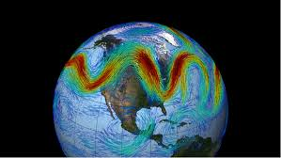
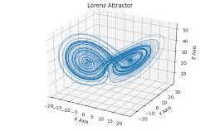
Problem description
Our goal is to build surrogate models with performance guarantees for computation-intensive components of medium-term weather forecasting using machine learning.
We start with benchmark chaotic dynamical systems widely studied in the weather forecasting literature: Lorenz63, Lorenz40, Lorenz96 and KS.

Slide 3
Our goals
Predicting chaotic dynamical systems time series behavior using specialized recurrent neural network models, including:
ESN (Echo State Networks),
LSTM (Long-Short Term Memory)
Ensembles of ESNs and LSTMs
Finding the best predictive model for each of the benchmarks by developing a robust methodology for model evaluation and comparison
Understanding why a specific model architecture performs better than others on a given benchmark

Slide 4
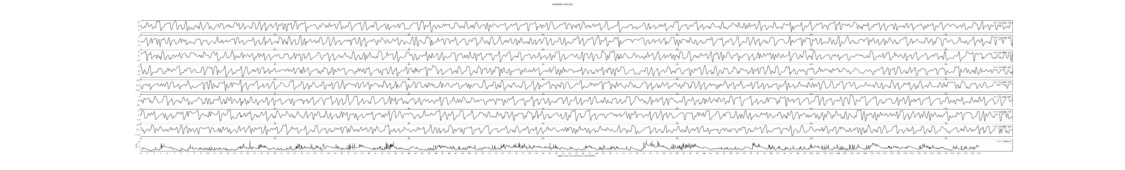
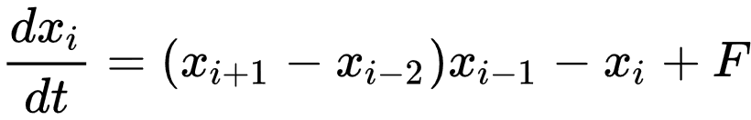
Time-series data taken from Lorenz96 system, containing 8 system variables
For each variable derivative is calculated using the following equation:
Absolute variable values, ranging from -2 to 2
Forcing factor, influencing the complexity of generated data (degree of chaotic behavior)
Propagation through time

Slide 5
What is hard about predicting chaotic dynamical system – what is hard about building surrogates?

Slide 6
Show 2 ICS with either 8 graphs or a subset: two panels where you show one IC with a long prediction horizon and one with short. And both are for the same model.

Slide 7
Now show the 25000 time step prediction horizon plot and zoom in the two you showed before.

Slide 8
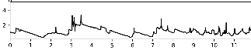
Prediction horizon
Prediction horizon: how many predictions of the next time-step produced small enough error compared to the actual data, before the error accumulates
Prediction horizons of a model, achieved on each initial condition from the set of consecutive system states:
X-axis: Relative time point of each evaluated initial condition in MTU
Y-axis: Prediction horizons for each densely plotted initial condition in MTU
E.g. prediction starting from the initial condition at 10.6 MTU from the first one in the set, has produced the prediction horizon of 2.2 MTU
MTU
MTU

Slide 9
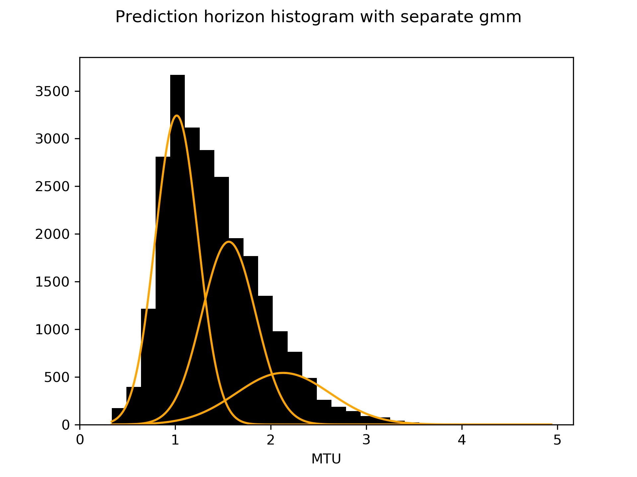
Prediction horizon histogram
Hard initial conditions
(low prediction horizons)
Number of initial conditions resulting in a
specific prediction horizon (out of 25000)
Medium initial conditions
Easy initial conditions
(high prediction horizons)
Prediction horizon values achieved by evaluated initial conditions
E.g. there are around 1000 initial conditions that have produced prediction horizons between 2 and 2.2 MTU

Slide 10
Why mixtures of Gaussians

Slide 11
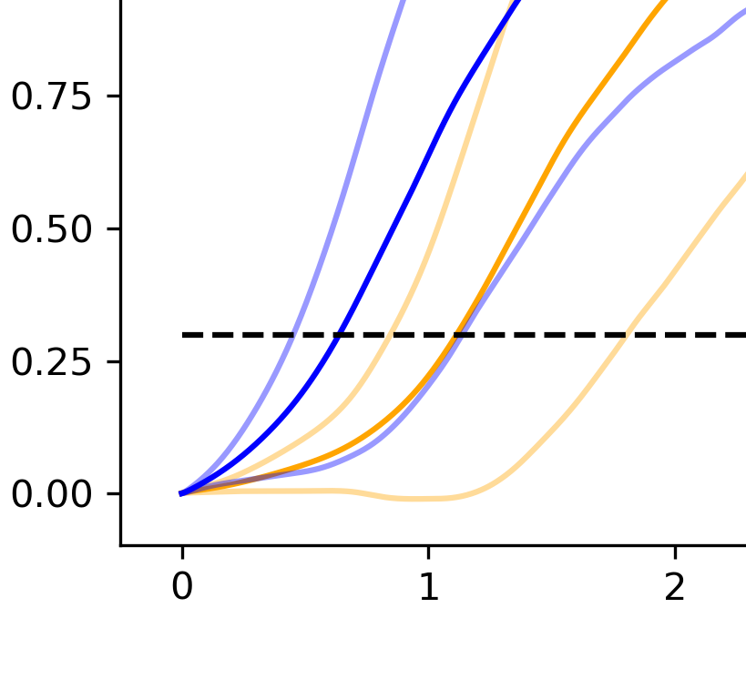
Average error and variation of two models on random 100 ICs
The average error and its standard deviation is displayed by blue, and another’s by orange line
Although one model seems to cross the prediction horizon threshold sooner, the graph is still ambiguous
Mean squared error and
its standard deviation
Prediction horizon threshold
Number of predicted time steps in MTU

Slide 12
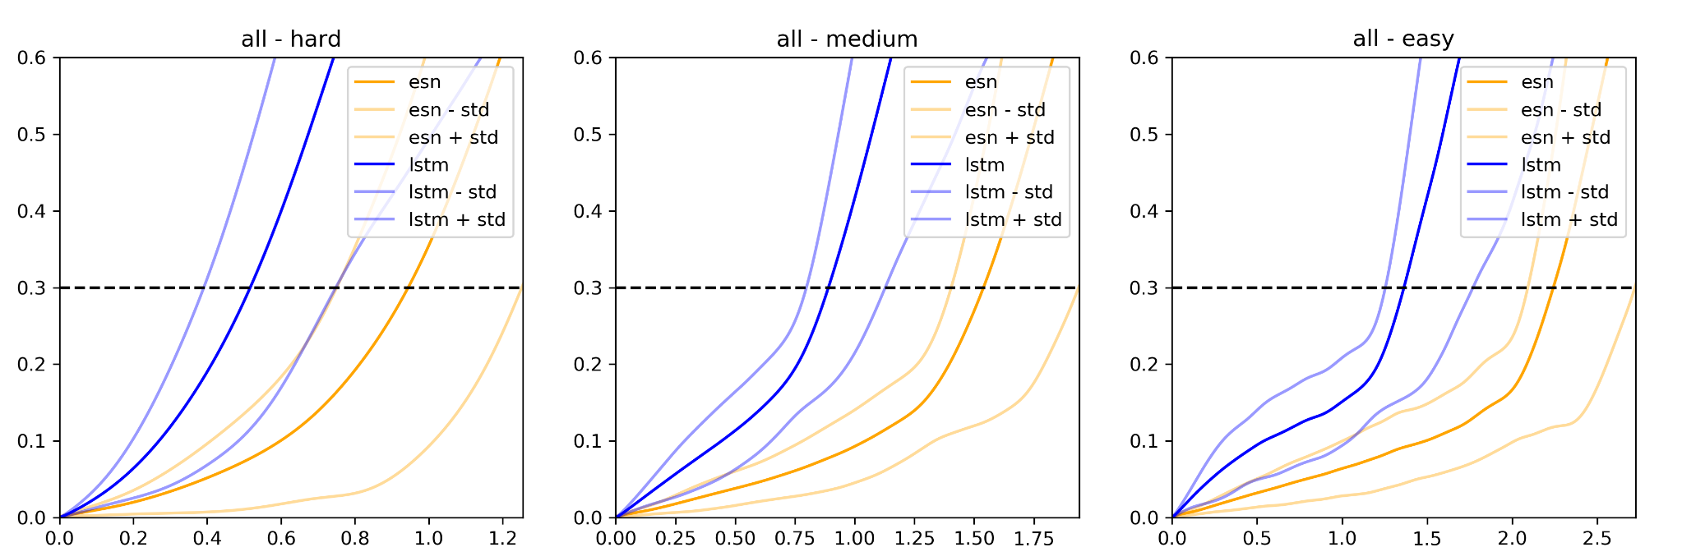
Average error and variation of two models on hard, medium and easy initial conditions
Mean squared error and
its standard deviation
Number of predicted time steps in MTU
E.g. average LSTM error crosses the threshold at 0.5 MTU, while average ESN error crosses the threshold at 1.0 MTU, for initial conditions regarded as hard
Now the ESN model is clearly better

Slide 13

Our benchmark framework
Lorenz96 is also
Available at
https://rmets.onlinelibrary.wiley.com/doi/full/10.1002/qj.2974
The ML models are designed for short-term forecasting of chaotic dynamical systems
Each chaotic dynamical system is described by a system of PDEs (Partial Differential Equations)
Problems that we plan to benchmark:
Put Lorenz63, Lorenz40
And Lorenz96 as separate
Systems. Get the equations
For Lorenz40 from Vlachas,
Get Lorenz96 from Ashesh
And Lorenz63 as well as KS from Pathak
Lorenz: Lorenz96, Lorenz63, Lorenz40
Kuramoto-Sivashinsky (KS)
One more problem to be named later

Slide 14
Data generation
We have Python scripts that can be found inside the project folder data_sets that implement Runge–Kutta (RK4) integrator for benchmark systems:
Lorenz63 and Lorenz96 and Lorenz40
KS
These scripts generate ground truth multi-variate time series data for training and testing models

Slide 15
State of our work
How
We have focused on Lorenz96 variant of Lorenz system and produced analysis on its data.
To gain enough results and support our methodology, we are aiming to apply our project pipeline to additional chaotic dynamical systems benchmark problems.

Slide 16
The analysis pipeline
Acquire dataset for analyzed chaotic system
Parametrize the code to use desired:
Input data
Model type (ESN, LSTM, ensemble)
Model hyper-parameters (input dimension, model size, …)
Execution hyper-parameters (size of training and testing sets, …)
Train the model and execute prediction analysis on multiple sets of execution hyper-parameters to find the best ones for the model
Execute comparative analysis between different models

Slide 17
Getting started with the project
Familiarize with the code, play with parameters and try to reconstruct existing results
Project file structure:
Folder script – Implementations of ML models used in the project
Folder datasets – Dataset generators and generated chaotic system data
Folder Lorenz_96, 200, 1 – Generated data buffer, avoiding repeated calculation
default_esn.json, default_lstm.json – Auto-loaded model hipper parameters
default_run.json – Prediction hipper parameters (dataset split, …)
pred_horizon_stats.py – Train the model, execute prediction and plot graphs
combine_graphs.py – Loads predictions of two existing trained models, executes comparative analysis and plots graphs

Slide 18
Some terminology
Model – Implementation of specific machine learning algorithm
Model parameters – Number of input elements and hidden units, training set size, model specific constants, randomization seeds
System state – Set of numerical values (system variables)
There are 8 system variables for Lorenz96 system
Initial condition – System state the prediction is starting from
MTU (Model Time Unit) – Unit of time describing chaotic system data
For Lorenz96 system, 1 MTU is an interval containing 200 discrete time points
Each time point is represented by one system state which can be used as an initial condition

Slide 19
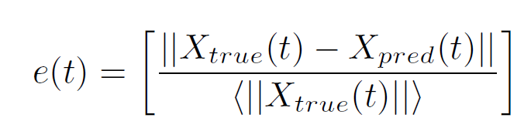
The error metric
The error metric we used to estimate the quality of prediction is an averaged relative L₂ error between the true and predicted trajectories
Following formula represents the average error on each time-step
Average over all predicted
initial conditions (25000)
Average of absolute X_{true} over all predicted
initial conditions (25000) for each time-step t

Slide 20
Your task
Apply the provided code on data representing different chaotic dynamical systems:
Adapt the code parametrization to align with dataset properties (dataset name and input path, input size)
Execute predictions and search for the best model parameters for the given system (using smaller and quicker testing sets), for different models (ESN, LSTM, ensemble)
Execute performance analysis on bigger testing set for each model (this will take the most execution time)
Execute comparative analysis between different models using the same predictions generated during individual performance analysis

Slide 21
Thank you for your attention

